Slide 1

Trigonal Badge Defense
2026.6.4
20248225
Eason Zhuang Yichen

Slide 2
Treating Waste with Waste –
Study on Photocatalytic Performance of Modified Banana Peel Loaded with TiO₂ and Its Reactor Integration Design

Slide 3
01
Background

Slide 4
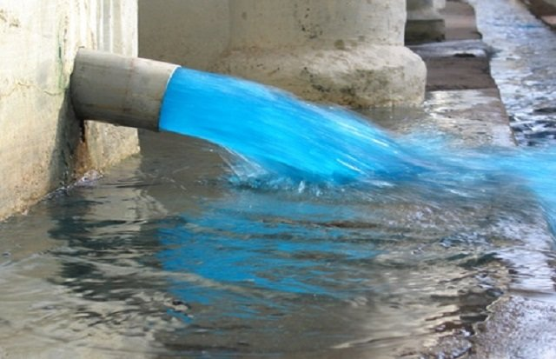
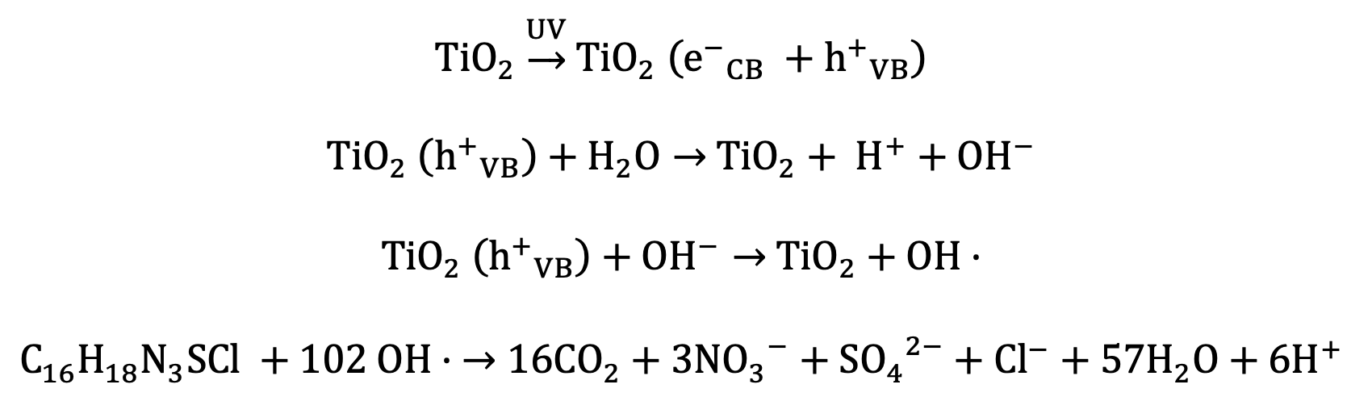
Background
Titanium(IV) Oxide:
Pro: can degrade organic dye
Con: low reaction efficiency
Major waterbody pollutant: organic dye

Slide 5
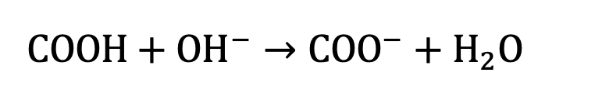
Background
TiO₂ loading in pores.
Constructing pores: Esterification
Citric Acid (CA)
Banana Peels
  Cellulose
Major waterbody pollutant: organic dye
CA modified banana peels loaded with TiO₂ (CA-TiO₂)

Slide 6
Research Goal
Chemistry Part
Find how concentration of citric acid in the step of modification help promote Ca-TiO₂ property
Find and evaluate the best-functioning material
Engineering Part
Design and make a device to promote application of Ca-TiO₂

Slide 7
02
Chemistry Part:
Synthesis & Testing

Slide 8
Hypothesis
As the concentration of citric acid increases, more abundant pores will be constructed as more esterification is taking place.
Therefore, more TiO2 will be loaded and a higher proportion of methylene blue in the solution will be degraded and absorbed.

Slide 9
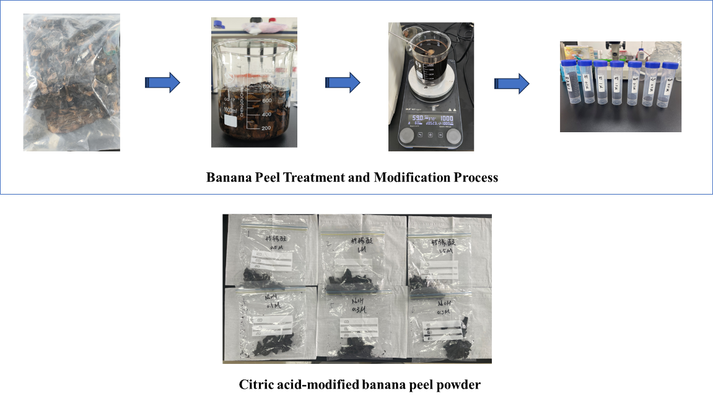
Modification Procedure

Slide 10
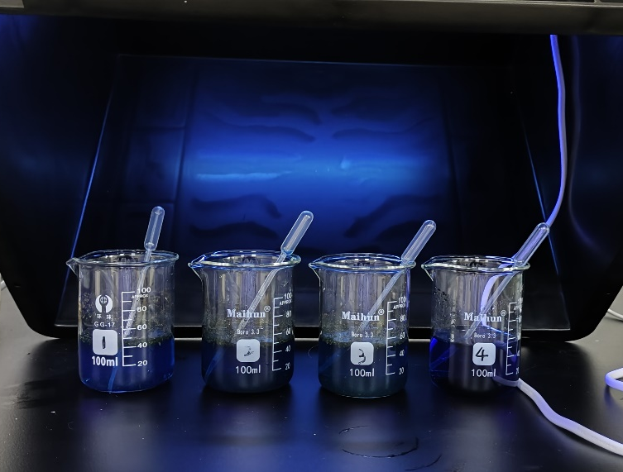
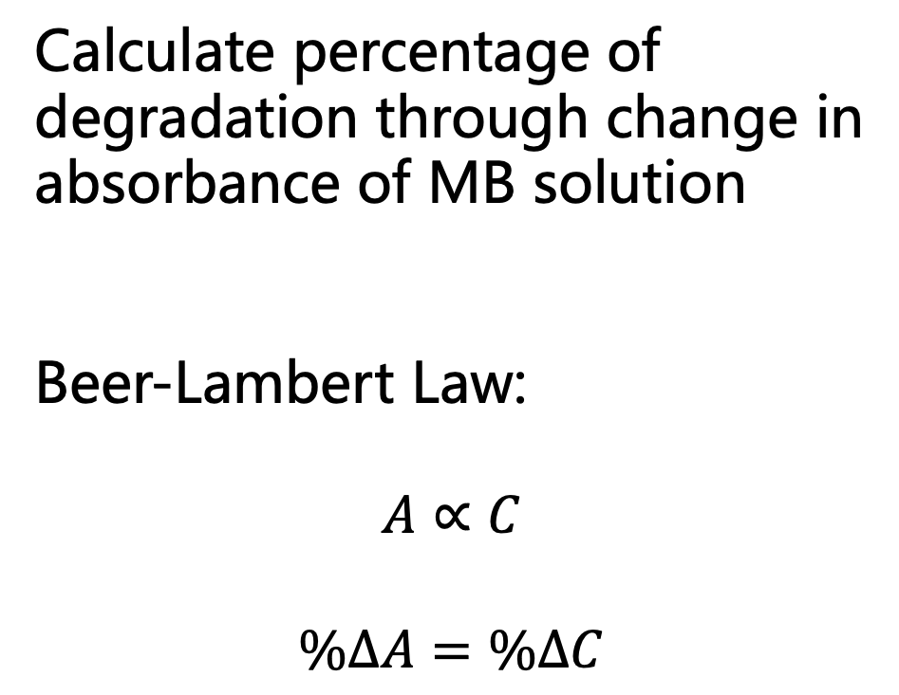
Testing
Calculate percentage of degradation through change in absorbance of MB solution
Beer-Lambert Law:
$$A∝C$$
$$\%∆A=\%∆C$$
Experiment 1
absorption under UV catalysis

Slide 11
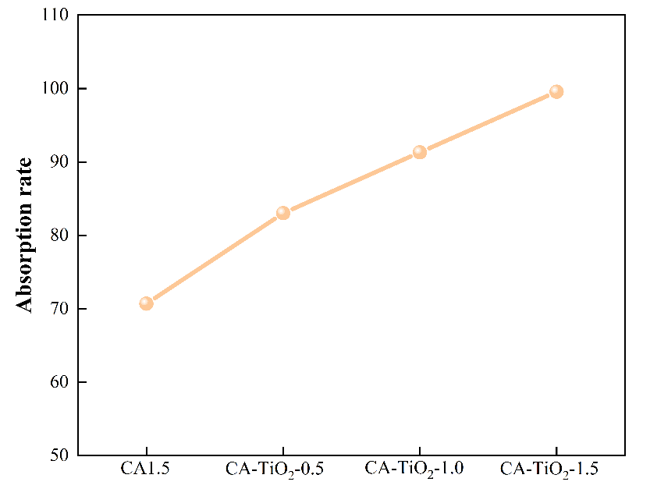
Testing
Positively Relative Linear Relationship
CA-TiO₂-1.5 has most outstanding effect

Slide 12
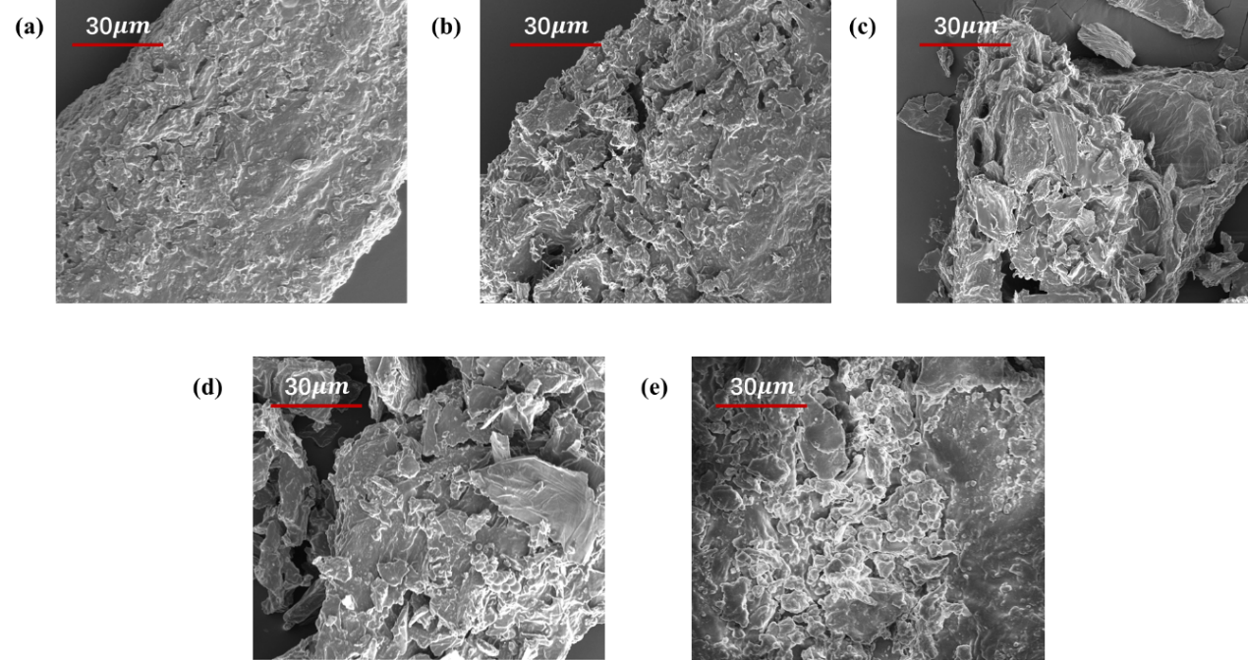
Testing
unmodified banana peel
(b) CA0.5
(c) CA1.0
(d) CA1.5
(e) CA- TiO2-1.5
SEM Testing

Slide 13
Testing
H3-type hysteresis loop
Mesopores
With SEM, explains CA-TiO₂-1.5 high absorption potential under photocatalysis
BET Testing

Slide 14
03
Physics Part:
Application

Slide 15
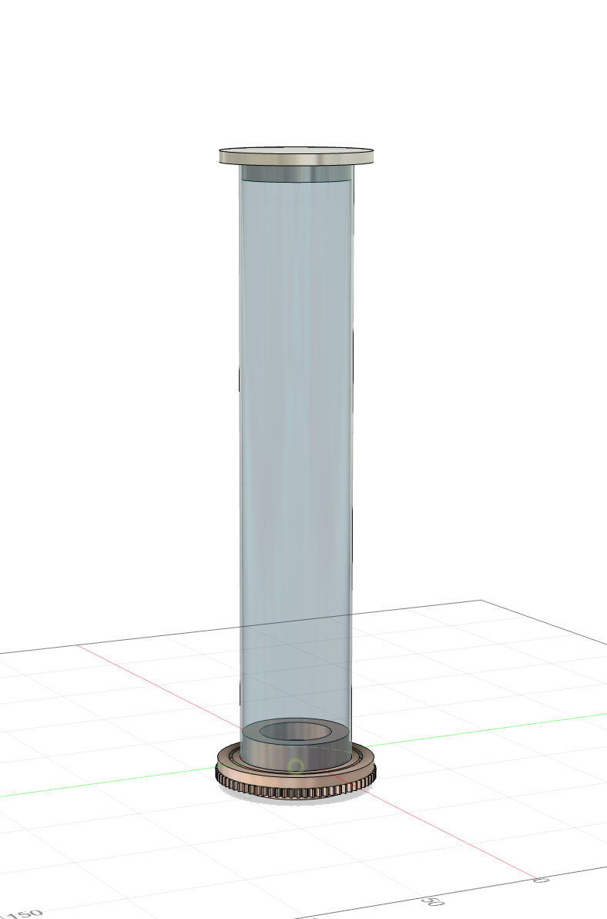
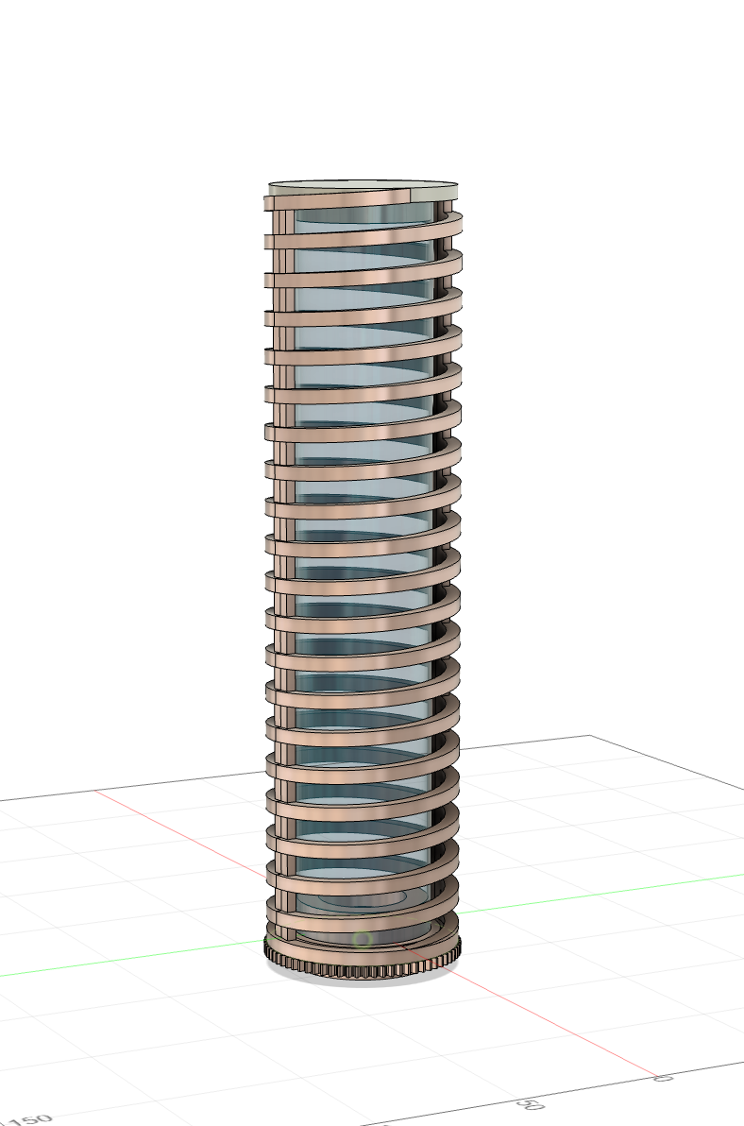
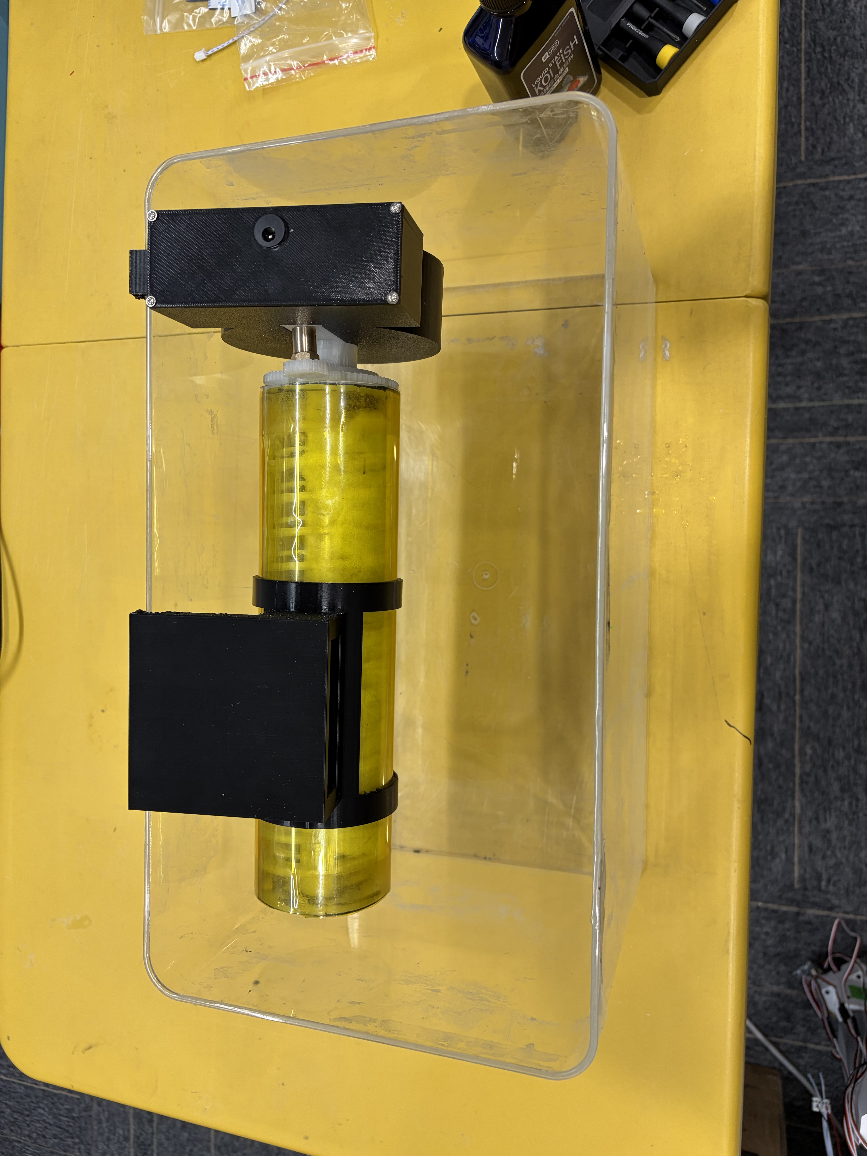
Device Design

Slide 16
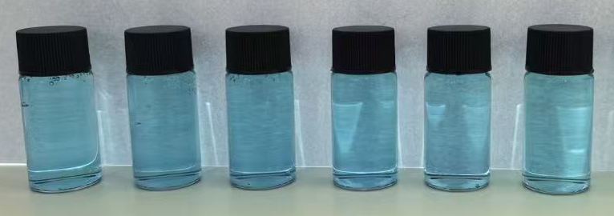
Testing
Samples collected
(Left to Right):
0 hour
1 hour
2 hours
3 hours
18 hours
40 hours
Samples from Experiment 2:
Absorption Effect with Time

Slide 17
Testing
Highest effectiveness during first 5 hours
Effect decreases with time

Slide 18
04
Conclusion

Slide 19
Conclusion
Results
Concentration of citric acid in banana peel modification is positively proportional to material functioning
  Ca-TiO₂-1.5 has the greatest effect
Ca-TiO₂-1.5 can remove up to 30% of methylene blue contaminants within 5 hours under weak photocatalysis
Future Plans
Prolong the high-effectiveness time span of Ca-TiO₂-1.5

Slide 20
05
Reference

Slide 21
Reference
[1] Zhang, Y., Zhang, J., Chen, K., Shen, S., Hu, H., Chang, M., Chen, D., Wu, Y., Yuan, H., & Wang, Y. (2023). Engineering banana-peel-derived biochar for the rapid adsorption of tetracycline based on double chemical activation. Resources, Conservation and Recycling, 190, 106821.
[2] Eswaran, P., Madasamy, P. D., Pillay, K., & Brink, H. (2025). Sunlight-driven photocatalytic degradation of methylene blue using ZnO/biochar nanocomposite derived from banana peels. Biomass Conversion and Biorefinery, 15(8), 12347-12367.
[3] Kapoor, R. T., Rafatullah, M., Siddiqui, M. R., Khan, M. A., & Sillanpää, M. (2022). Removal of reactive black 5 dye by banana peel biochar and evaluation of its phytotoxicity on tomato. Sustainability, 14(7), 4176.
[4] Ashfaq, A., Nadeem, R., Bibi, S., Rashid, U., Hanif, M. A., Jahan, N., ... & Naz, M. (2021). Efficient adsorption of lead ions from synthetic wastewater using agrowaste-based mixed biomass (potato peels and banana peels). Water, 13(23), 3344.
[5] Nixon, P. D., Raveendran, A., Gnanaraj, M. A., Jayaseelan, E., Preeyanghaa, M., Ananthi, N., ... & Dhanusuraman, R. (2025). Investigation of bismuth vanadate nanorods incorporated with banana peel biochar: multifunctional exploration as a photocatalyst and supercapacitors. Journal of Materials Science: Materials in Electronics, 36(30), 1-20.
[6] Jedynak, K., & Charmas, B. (2025). Assessment of Ammonia Adsorption Capacity on Activated Banana Peel Biochars. Materials, 18(14), 3395.

Slide 22
Thanks For Listening
2026.4
20248225
庄逸宸

