Slide 1
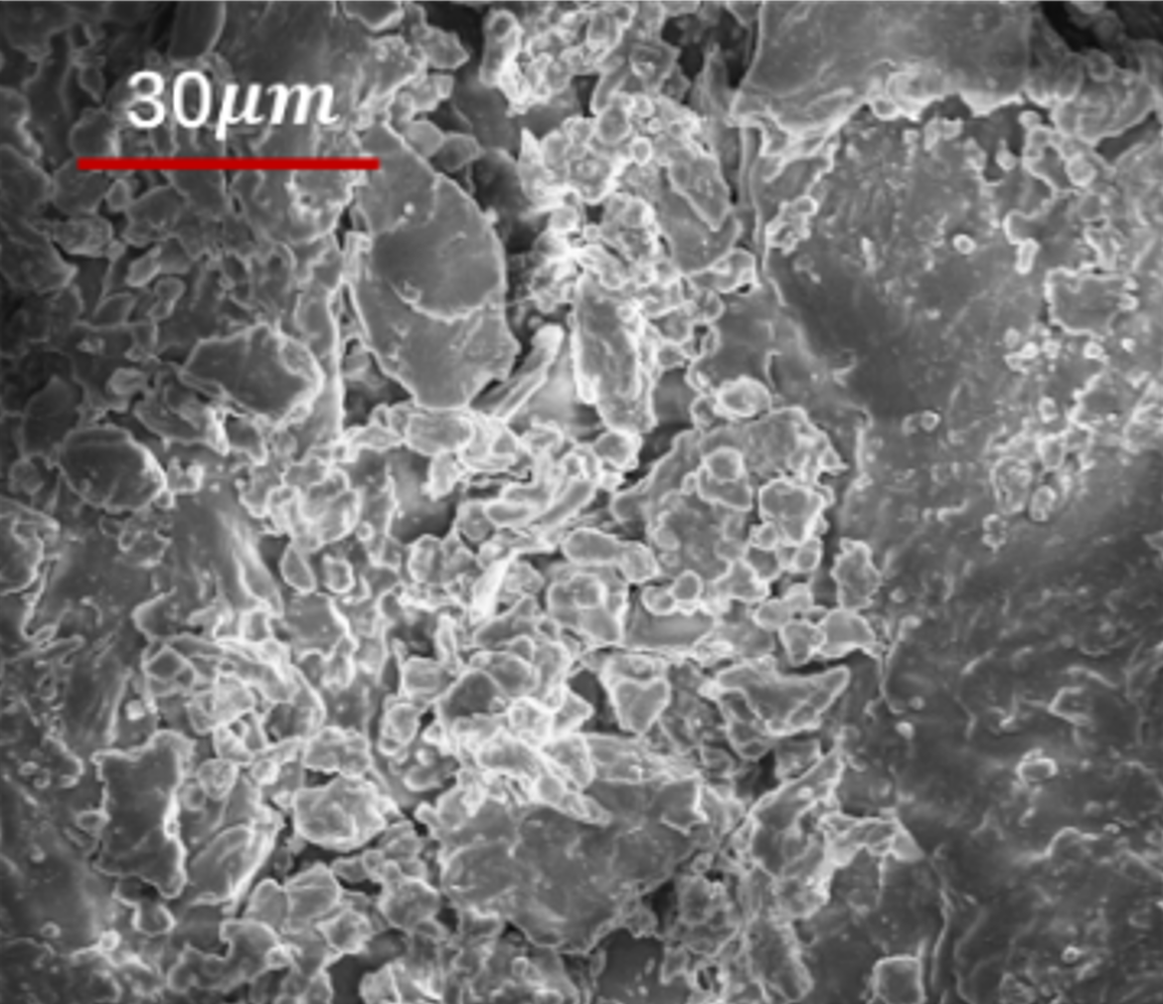
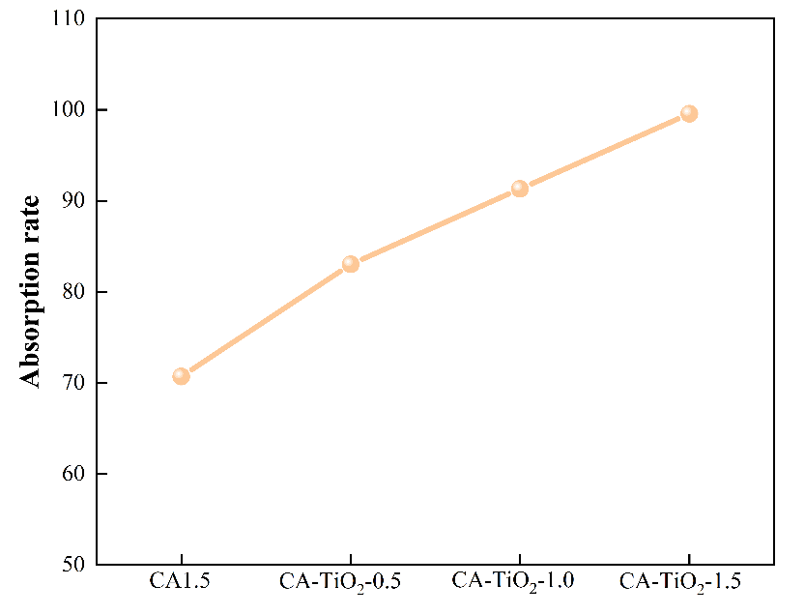
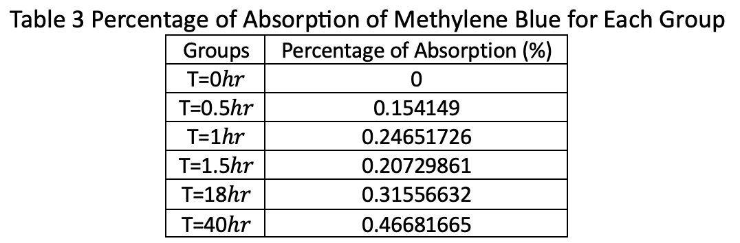
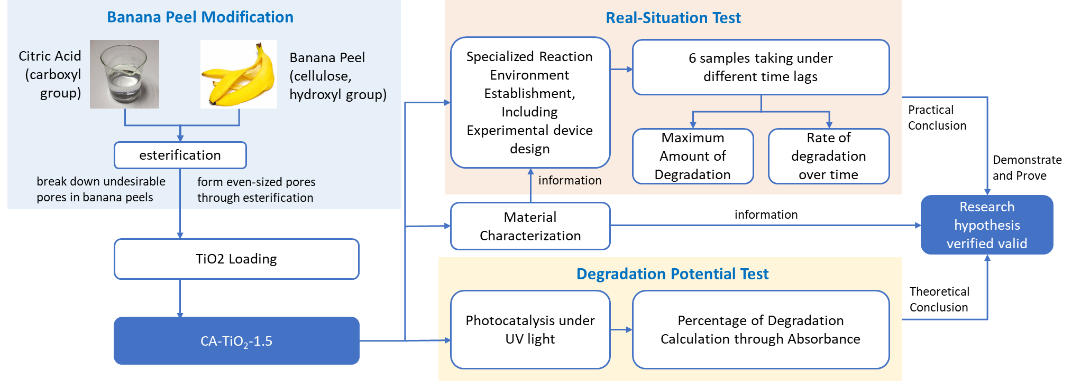
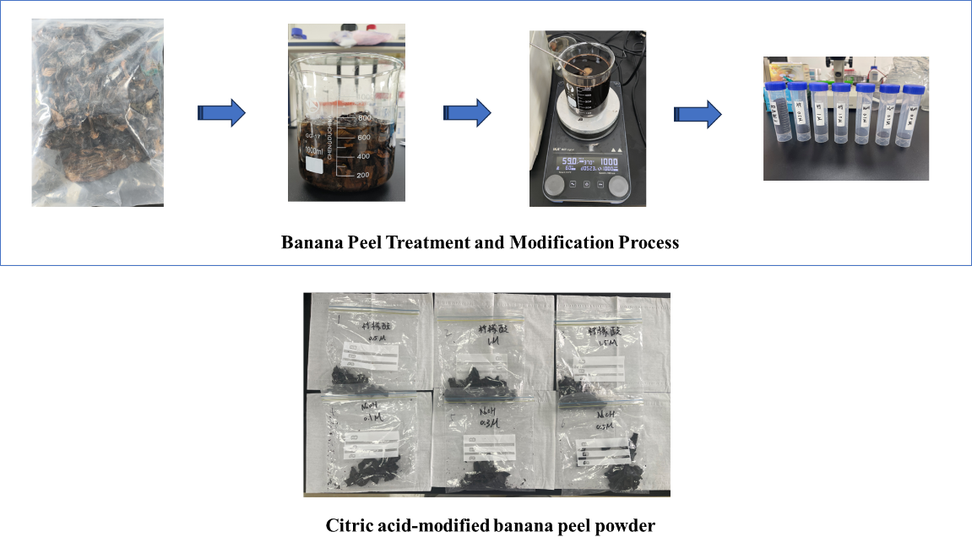
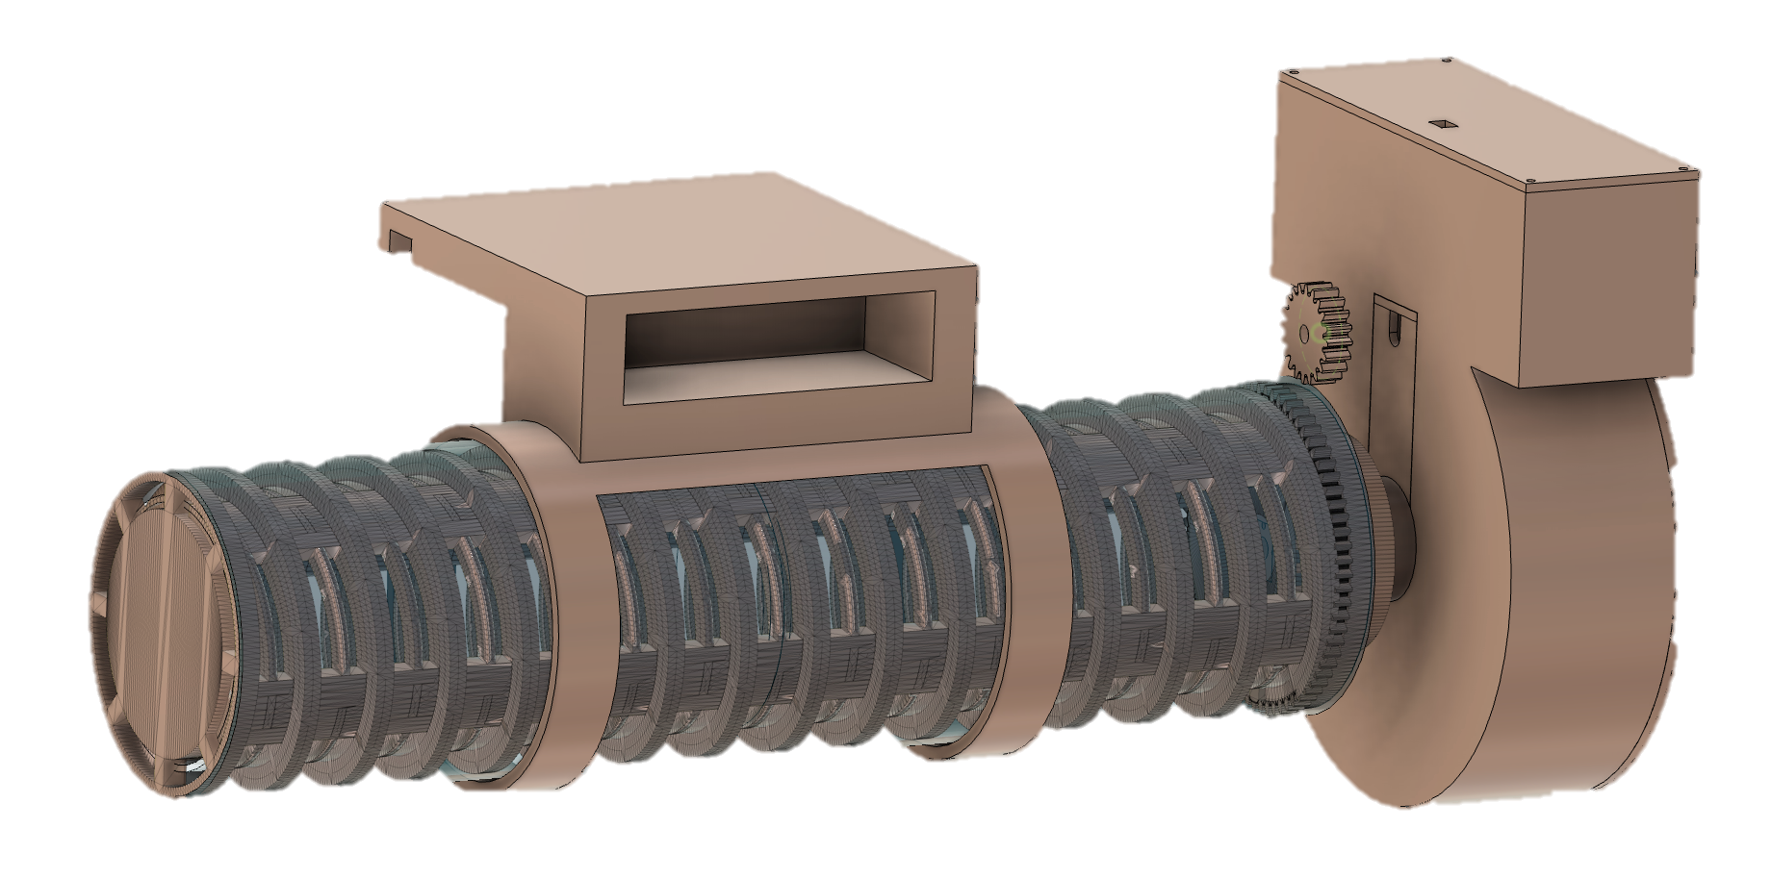
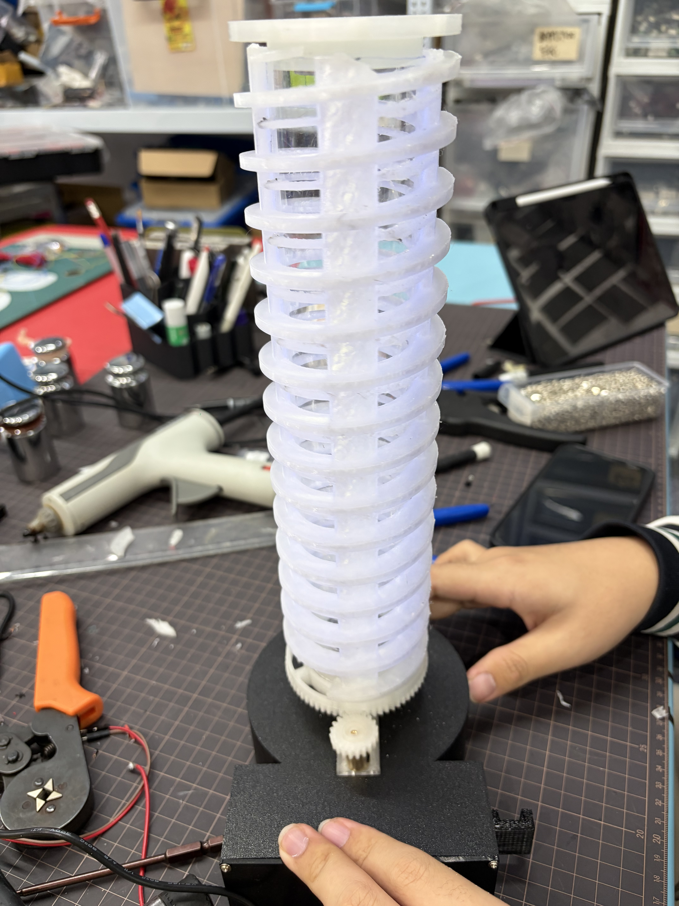
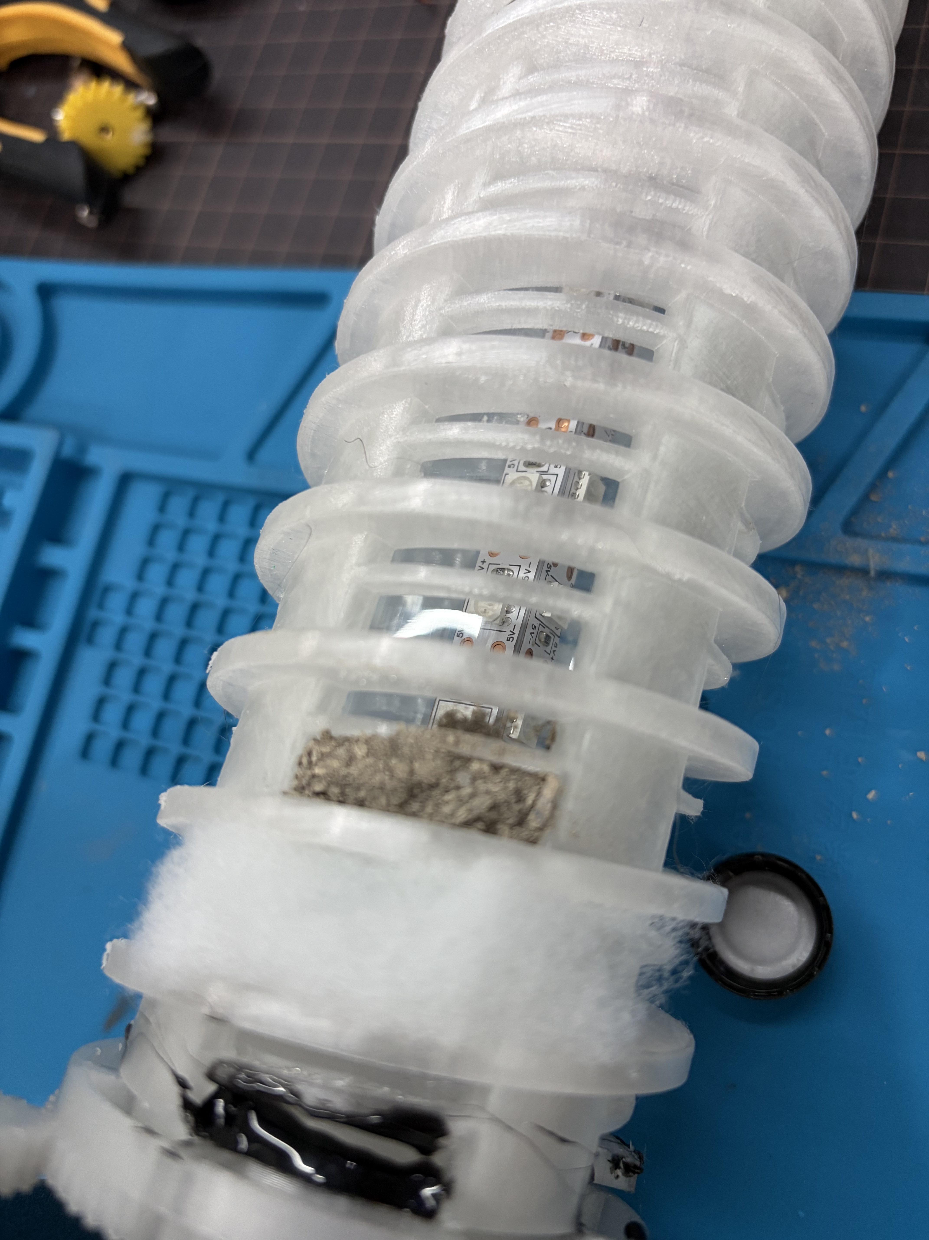
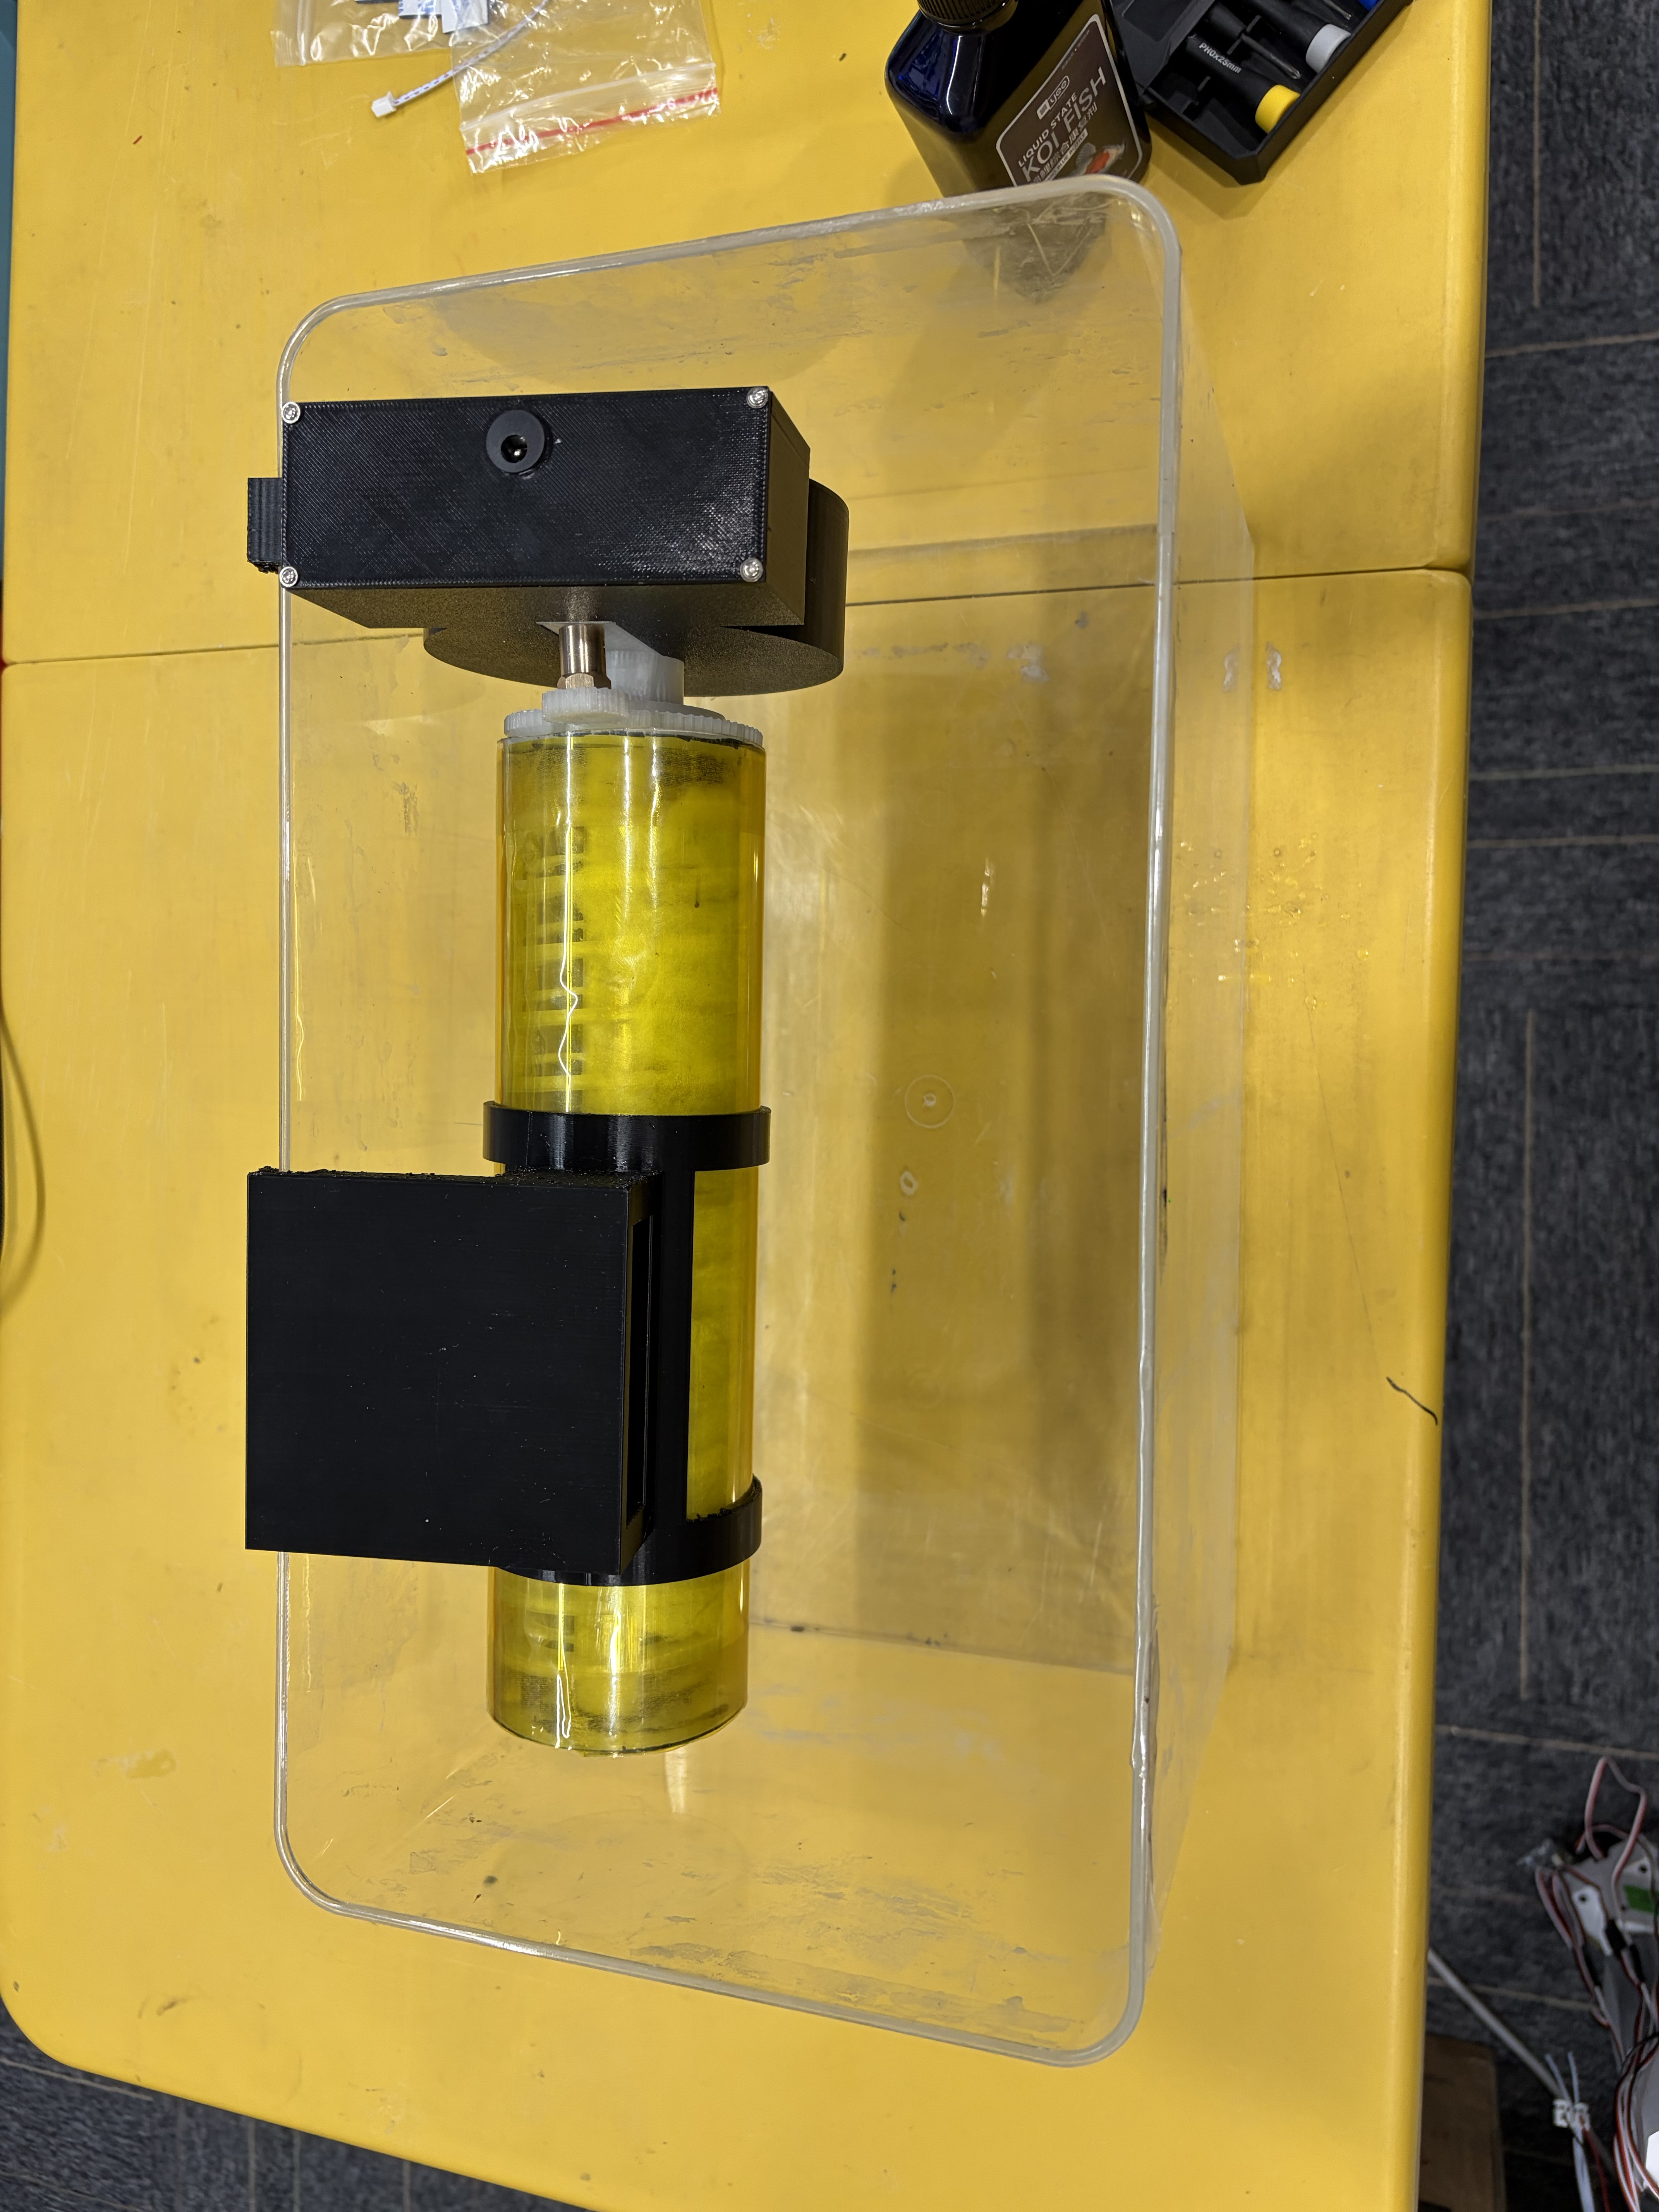
Treating Waste with Waste - Study on Visible-Light Photocatalytic Performance of Modified Banana Peel Biochar Loaded with TiO₂ and Its Reactor Integration Design
Yichen Zhuang, Shanghai World Foreign Language Academy, China
Project ID: 8100
Research Question
Data Analysis & Results
How does citric acid modification affect the functional group structure and pore characteristics of banana peel?
What are the optimal citric acid modification concentration and TiO₂ loading amount to achieve the highest removal efficiency for methylene blue?
How does the composite material achieve the synergistic effect of adsorption enrichment and photocatalytic degradation, thereby improving overall purification efficiency?
How can a continuous-flow reaction device be designed to achieve dynamic and continuous operation of the material?
Degradation Potential Test
The best product (CA-TiO2-1.5) can remove 97.74% under most desirable environment
Real Situation Test
Methodology
CA-TiO2-1.5 can remove 46.68% in limited time with the specially designed device
Conclusion & Interpretation
This research indicates that CA-TiO2 has significant potential in dye degradation.
However, the environment for the reaction is highly critical and unachievable in everyday life. Though the degradation percentage is lower than maximum value, it is still remarkable, validating the effectiveness of this chemical as well as the reaction device.
Future improvements device design can help further expand this product’s degradation ability.

